Slide 1
IOT Power Considerations

Slide 2
Two Types of Power Sites
Sites with Power and Sites without Power
My irrigation system that I developed requires ac power brought to the site.
For sites that have wells this is not a problem
The solenoid valves that I use require about 4.5 watts to operate.
The max irrigation draw would be 18 watts ( 4 valves )
There are sites in Deluz where there is no electrical is present.
Uses Rancho Water
Even though electrical lines are overhead, cost would be prohibited to install electric for irrigation control.

Slide 3
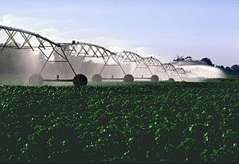
Sites where power will never be added
However, flow metes mounted on the unit will benefit operation.

Slide 4
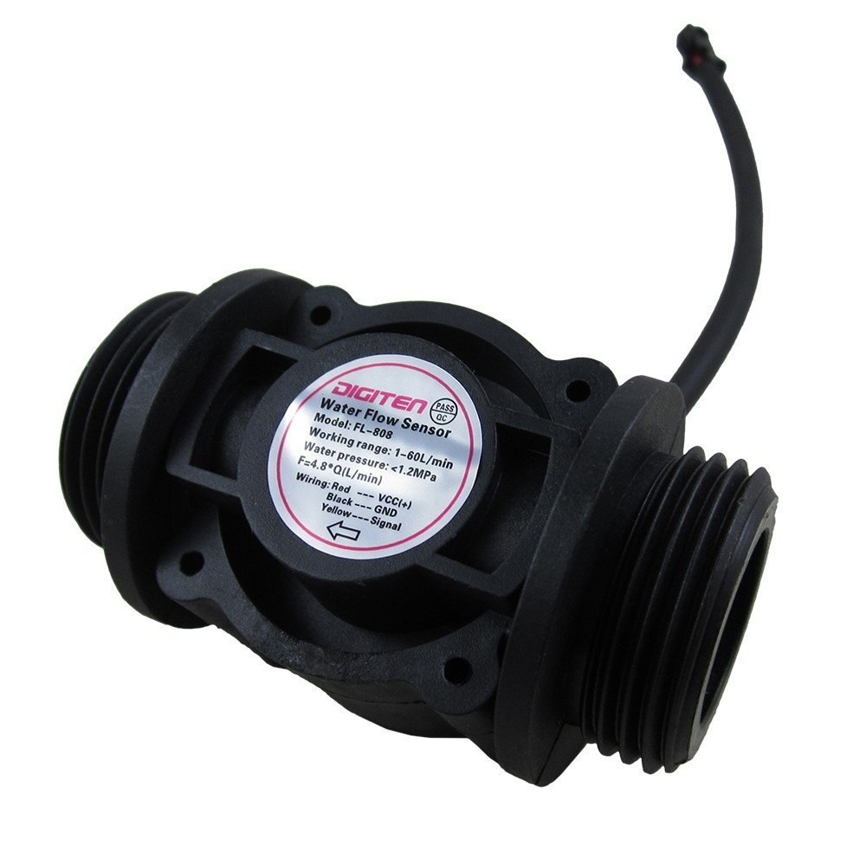
Flow meters can be cheap
Flow meters designed for appliances can
In agriculture applications.
This flow meter is $11.00
I used a flow meter like this in the field for
Over 1 year and had no problems with it.

Slide 5
Biggest Problem with Flow Meters
Cannot reliabily detect bad emitters.
Standard deviation of measurement is +.15 gpm
For a 14.5 gph emitter the flow rate is .24 gpm
In this case there is a 50% of Detecting a Bad Emiter
And a 50 % chance of False alarm
For two bad emitters the odds are very good of detection
For a 5 gph emitter with a .08 gpm the odds are not good.
The solution is to put flow meters on the small flow sections of the irrigation lines.
Problem is power.
Processor has to on to count pulses
No battery powered processor can do this.
Exception FRAM MSP430
Done it for German Apartment Building with battery life of 5 years

Slide 6
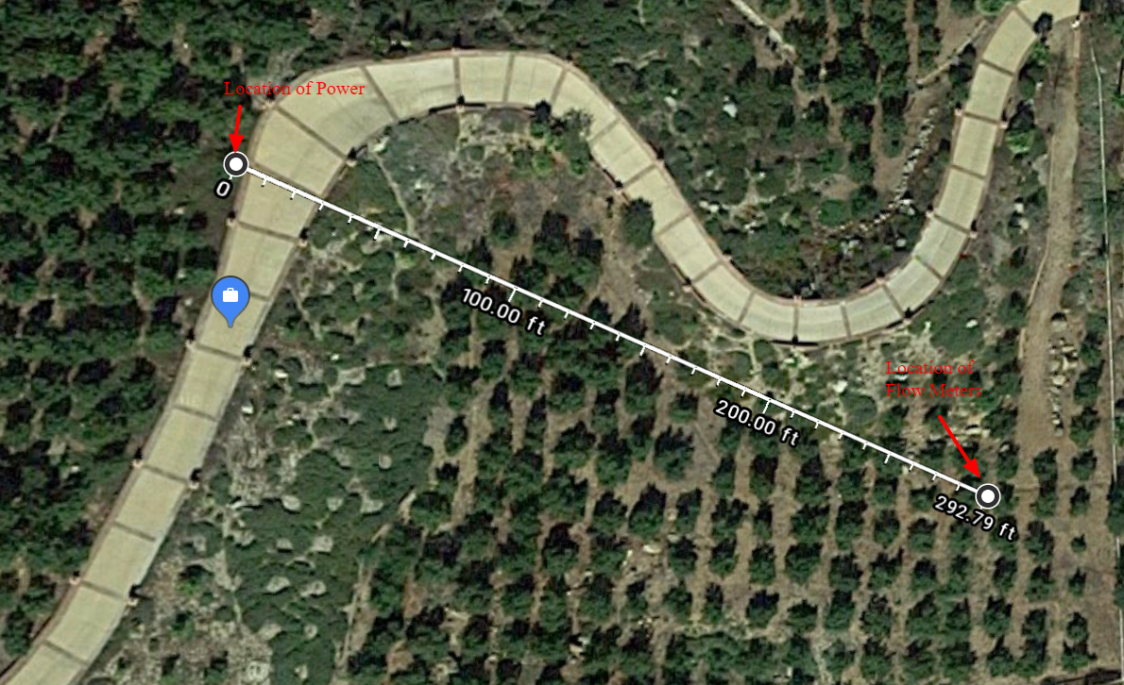
Problem is that the flow meter is in an area where there is a lack of electrical power Picture from my grove
At 12 GPM and at least 30 psi
Head the power generated by
a water turbine has capacity of
157 watts
More than enough to power flow
Meters or valves

Slide 7
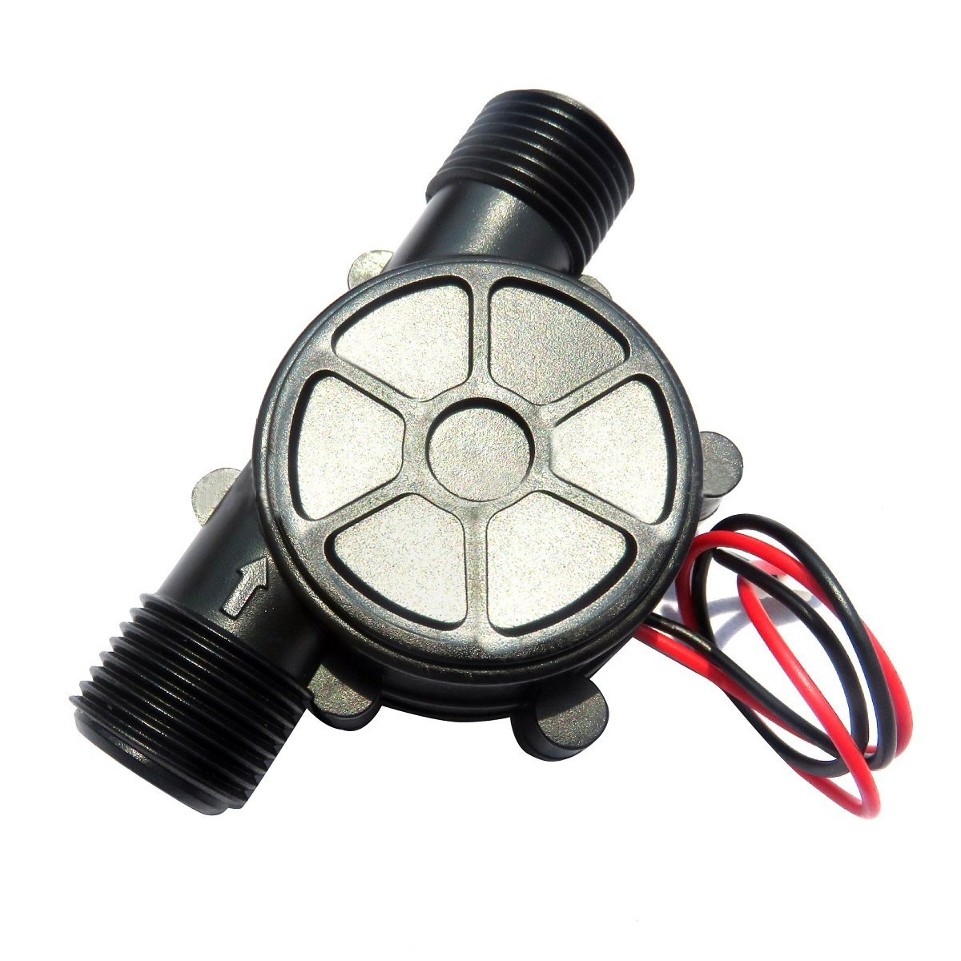
Low Cost Generators Available??
10 W various voltages
.25 inlet
$10.00
Need to up scale or fit multiple units
Into the system

Slide 8
What is need is a small water turbine powered subsystem
Irrigation Flow line
3~4 gallon per minute
Water
Turbine
Flow Meter
Pressure Reducing
Valve
Microprocessor
Mesh
RF Unit
Battery
And Battery
Charger

Slide 9
Mesh Unit will allow Units to communicate Across Fields
Mesh Units
Mesh Units
Mesh Units
Main Controller
Internet
Access

Slide 10
Product for Majority of California Agriculture
I do not have time to develop this product
I could use this product.
I will let some one prototype it on my site

